Slide 1
Object Oriented Programming ICT-1203
Dr. Jesmin Akhter
Associate Professor, IIT, JU

Slide 2
Read Input From Console

Slide 3
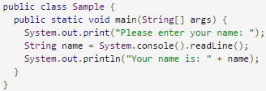

System.console().readLine()
The simplest way to read user input is by
using System.console(). Here is an example:

Slide 4
java.util.Scanner and System.in
Scanner class is present in java.util package so we import this package in our program. We first create an object of Scanner class and then we use the methods of Scanner class. Consider the statement
Scanner a = new Scanner(System.in);
Here Scanner is the class name, a is the name of object, new keyword is used to allocate the memory and System.in is the input stream. Following methods of Scanner class are used in the program below :- 1) nextInt to input an integer 2) nextFloat to input a float 3) nextLine to input a string

Slide 5
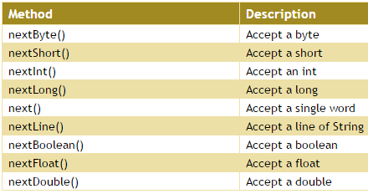
The Scanner class has several methods which are used to take different types of inputs.
Combining System.in and java.util.Scanner provides a way to read user input.
It also provides a way to read different data types.

Slide 6
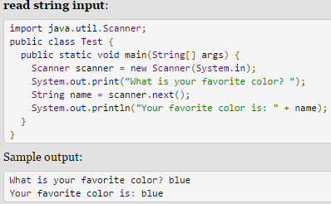
java.util.Scanner and System.in

Slide 7

java.util.Scanner and System.in
Read input string :

Slide 8
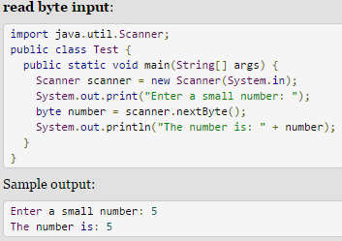
java.util.Scanner and System.in

Slide 9
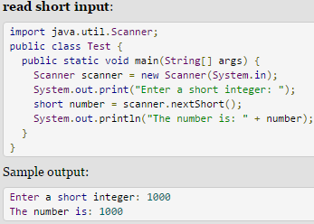
java.util.Scanner and System.in

Slide 10
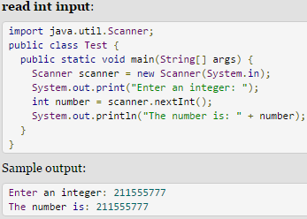
java.util.Scanner and System.in

Slide 11
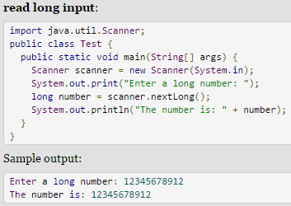
java.util.Scanner and System.in

Slide 12
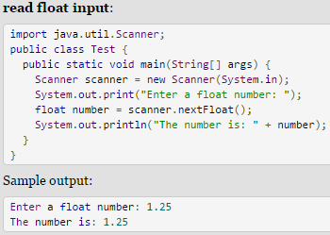
java.util.Scanner and System.in

Slide 13
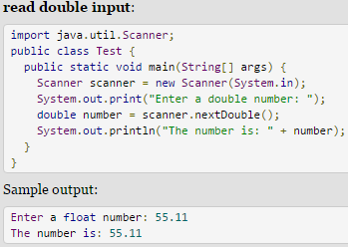
java.util.Scanner and System.in

Slide 14
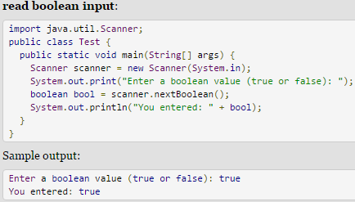
java.util.Scanner and System.in

Slide 15
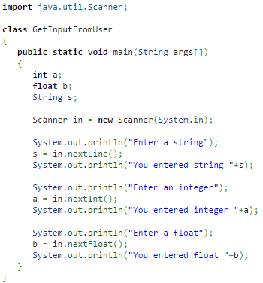
Example 1: input from user

Slide 16
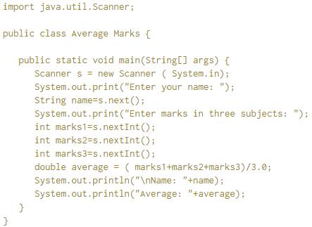
Example 2: input from user

Slide 17
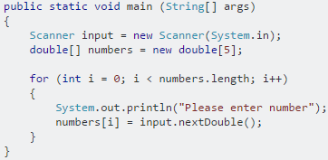
Example 1: How to put a Scanner input into an array

Slide 18
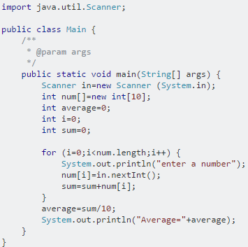
Example 2: How to put a Scanner input into an array

Slide 19
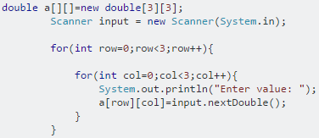
Input values into a 2d array

Slide 20
Input and storing Strings in two-dimensional arrays
import java.util.Scanner;
public class InputString {
public static void main(String[] args) {
String[][] Criminals = new String[3][3];
Scanner sc=new Scanner(System.in);
for (int row = 1; row < Criminals.length; row++)
{
for (int col = 1; col < Criminals[row].length; col++)
{
System.out.print("Enter a criminal name: ");
Criminals[row][col] = sc.next();
}
}
}
System.out.println(" criminal List:");
for (int row = 1; row < Criminals.length; row++){
for (int col = 1; col < Criminals[row].length; col++){
System.out.println("\t"+Criminals[row][col]);
}
}
}
}

Slide 21
import java.util.Scanner;
public class InputTwoDimension {
public static void main(String args[]){
System.out.print("2D array size : ");
Scanner sc=new Scanner(System.in);
System.out.print("Row size : ");
int rows=sc.nextInt();
System.out.print("Column size : ");
int columns=sc.nextInt();
System.out.println("Enter array elements : ");
int twoD[][]=new int[rows][columns];
for(int i=0; i<rows;i++)
{
for(int j=0; j<columns;j++)
{
twoD[i][j]=sc.nextInt();
}
}
System.out.print("\nData you entered : \n");
for(int i=0; i<rows;i++)
{
for(int j=0; j<columns;j++){
System.out.print(twoD[i][j]+" ");
}
System.out.println();
}
}
}
Output:
2D array size : Row size : 2
Column size : 2
Enter array elements :
3 5 6 7
Data you entered :
3 5
6 7

Slide 22
Thank you

